Slide 1
Observations on Homework
Overall, very high quality work and strong effort.
Conformance checker in Rapidprom is rather unstable. Much of the same information can be obtained or deduced from discovery operators
Six sigma a methodology for quality improvement—focus on process quality and defect removal. CRISP-DM focuses on data mining (and will include process mining). Both are complementary. Weaknesses of DMAIC:
"narrowly designed to fix an existing process" and does not help in "coming up with new products or disruptive technologies
"The dangers of a single paradigmatic orientation (in this case, that of technical rationality) can blind us to values associated with double-loop learning and the learning organization, organization adaptability, workforce creativity and development, humanizing the workplace, cultural awareness, and strategy making."^{[43]}
the "rigid" nature of Six Sigma with its over-reliance on methods and tools. In most cases, more attention is paid to reducing variation and searching for any significant factors and less attention is paid to developing robustness in the first place (which can altogether eliminate the need for reducing variation)
I have made a DMAIC methodology available to you in PRIMMS as a separate project.
Good job on process mining with Rapidprom (heuristic net)-dataset 1b. Almost everyone spotted the quote issue, and considered the efficiency issue. Why so many contacts per lead needed? Could this be reduced? And given the hypothesis, is the manager ready to move forward and force more quotes from sales people or is more evidence needed?
Goal is to work with the business. How you convey the message will be critical for your success. I looked for accelerator answers that addressed the business implications.
Don’t be afraid to use the full training dataset 2 to determine variable importance when using logistic regression, and linear regression. Both explanatory power and predictive accuracy are important. Explanation occurs before prediction. Consider Peirce’s different reasoning types within the scientific method.

Slide 2
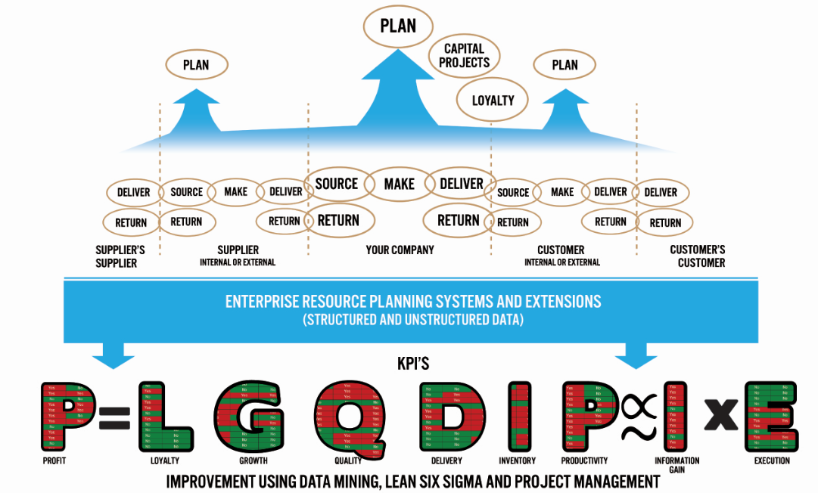
Adding the APICS
SCOR Dimension
Big Data
Target Variables

Slide 3
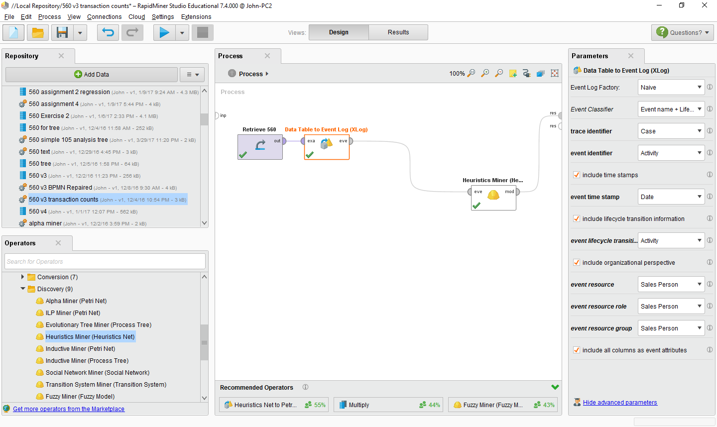

Slide 4
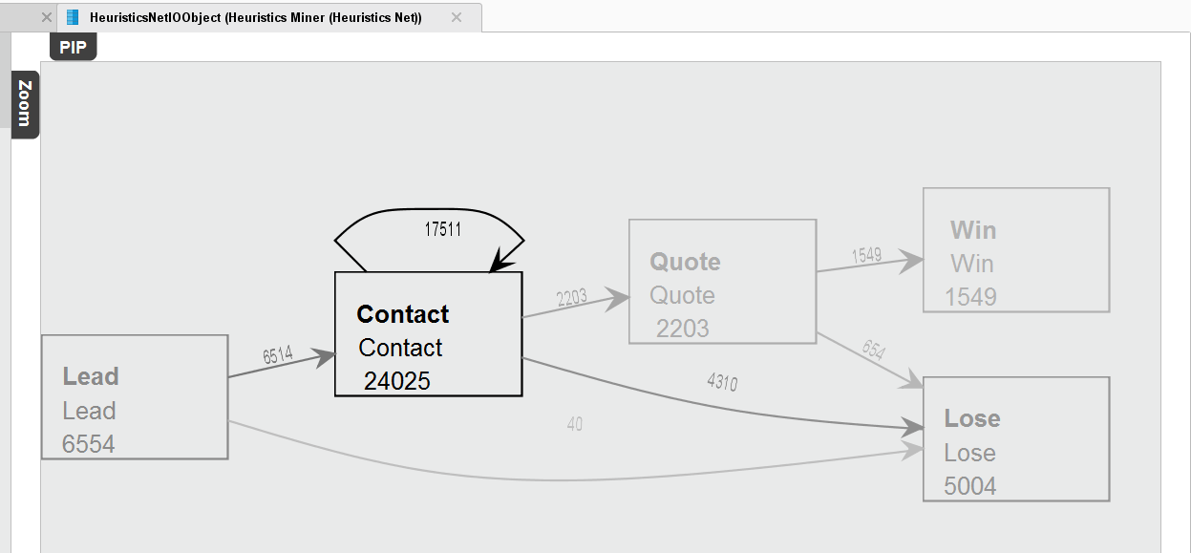
We discovered that quotes are related to performance, but do we just robotically demand more quotes or do we use the information to engage people to improve the process?
No, we engage the people in the process.
Also, can we improve efficiency here?
By deleting duplicate rows, we can check to see if all leads are being followed up.
The need for more quotes is a hypothesis at this point. Why would you send a quote to a potential customer who says: “Don’t bother me, I am not interested!”

Slide 5
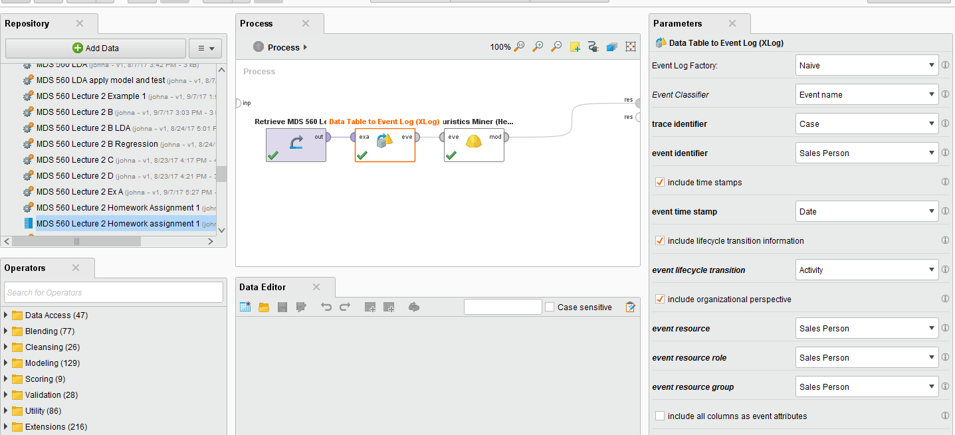

Slide 6
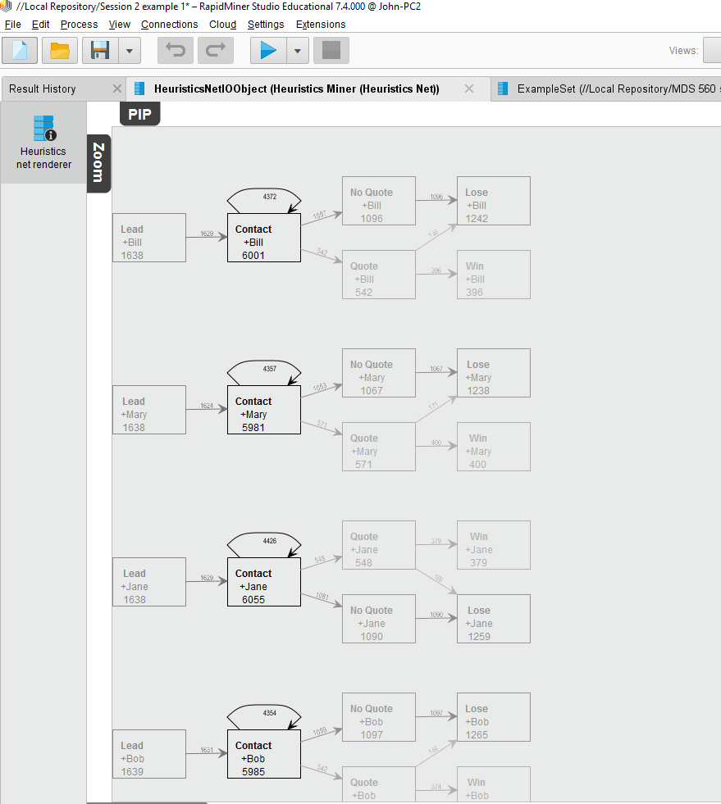
We always strive to relate performance to accountabilities.
Notice the similarity in rates of “No Quote”

Slide 7
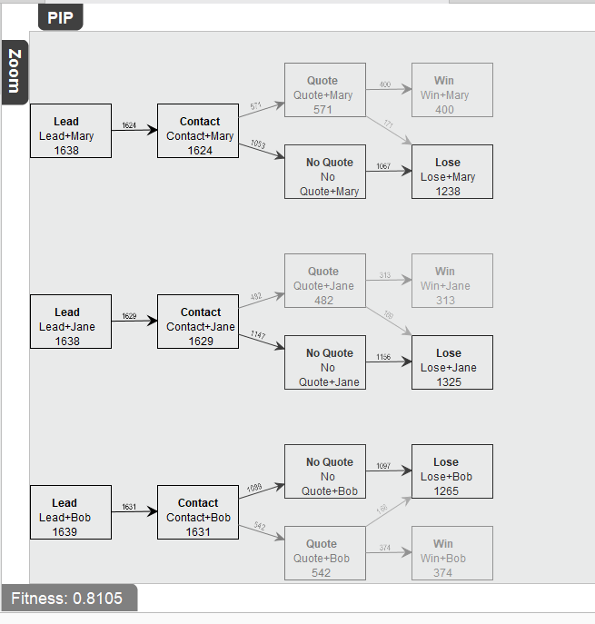
Lead to contact analysis.
Achieved by removing time stamp and eliminating duplicates

Slide 8
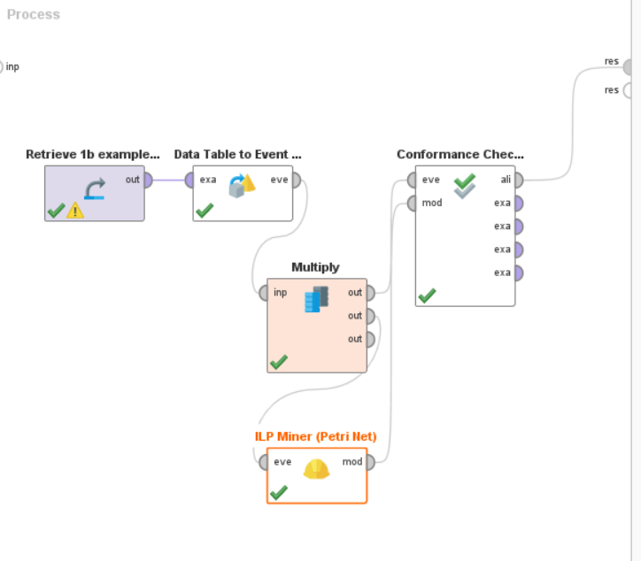
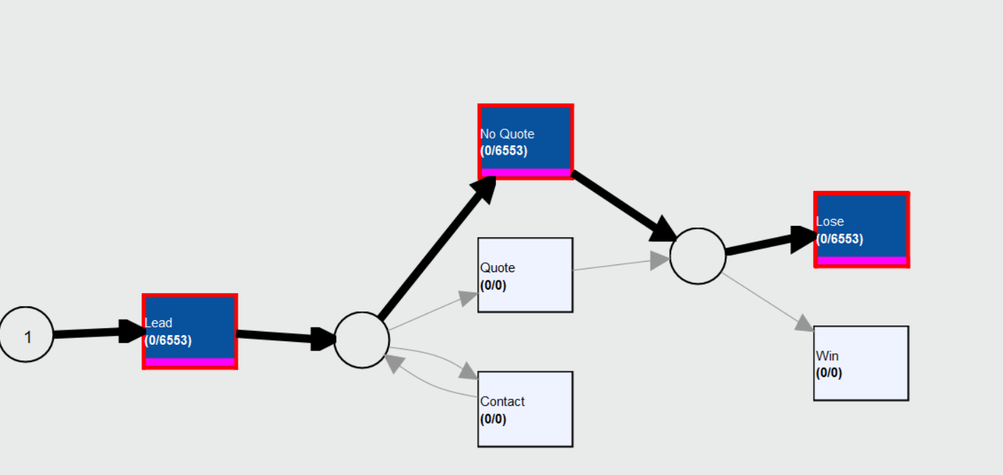
Going through the process of conformance checking has merit that goes beyond the stability and accuracy of the tool itself.

Slide 9
Relevant Words From Chief Inspector Morse Talking To Young Police Officer Kershaw…..
Morse: “In those police courses you take, has anyone ever told you the first principle of detection?”
Kershaw: “No, only how to do divisional planning reports.”
Morse: “The basis of detection is to keep asking why!”
Is the Manager Ready to Force More Quotes From Sales People Given the Evidence At Hand?

Slide 10
Peirce’s Trichotomy of the Scientific Method
As Self-Correcting Cycles Leading to the “Truth”
Consider The Five Whys.
In this case we worry about omitted variable bias.
Multiple
Hypotheses
Abductive
Reasoning
Begin Next Cycle with Convergence on “Truth”
What are Testable Conclusions About Other Phenomenon That Must Be Reached For Each Hypothesis if True?
Controlled Experiments Based Upon Samples From a Population (t-tests, F-tests from regression)
Explanatory
Hypotheses
Experience
What Must
Happen If True?
Deductive
Reasoning
Begin Research
Assess Results of Application and Adjust Hypotheses
A Question
Sufficient Accuracy Reached to Take Action
Elimination
of False Hypotheses
(retroduction)
Test Predictive
Models
Execute Actions
Inductive
Reasoning
Assess Accuracy
reflects imaginative interpretation of results.
Economics Plays a Role in Sufficiency Decision.

Slide 11

Dataset 1b
Note: To help you get through the notation of Hastie’s et al discussion of maximum likelihood, you might look at two additional videos. One covering gradient descent maximum likelihood as applied to linear regression. The other covering logistic regression. Links are below.
Dataset 2
https://www.youtube.com/watch?v=fkS3FkVAPWU
https://www.youtube.com/watch?v=TM1lijyQnaI

Slide 12
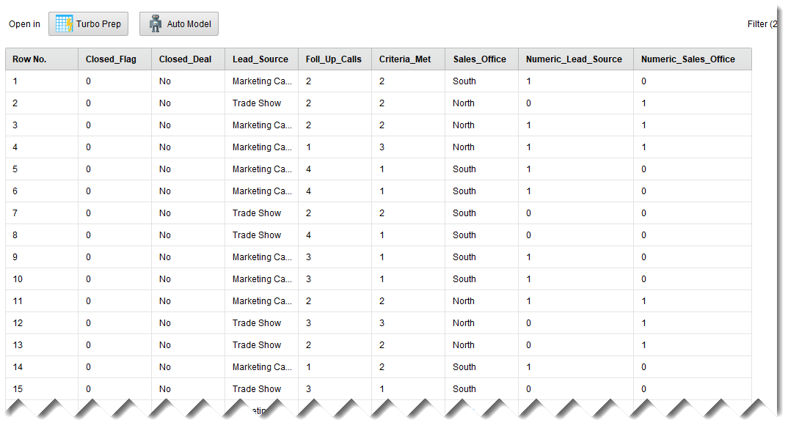
Dataset 2 Can Be Considered The Next Level of Detail for 1b. We Apply Classification and Regression Modeling to the Sales Force Productivity Example Using CRM Data
“Closed Deal” is binary or polynomial and is your Label (Dependent Classification Variable) that is to be predicted. “Closed Flag” is numeric and is your Dependent Variable for regression

Slide 13
Let’s briefly review the Mechanics of Rapidminer for regression modeling

Slide 14
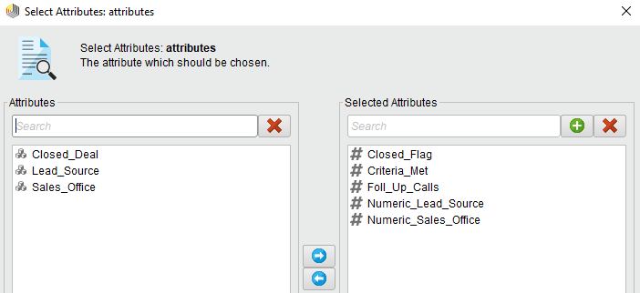
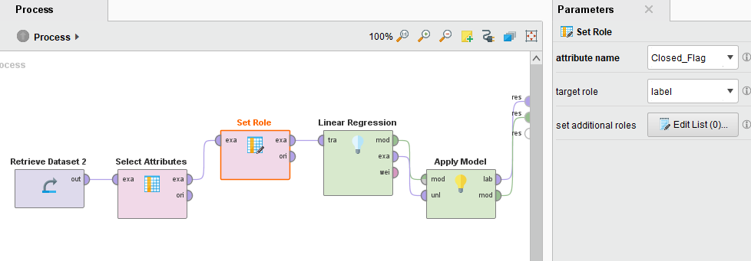
All variables must be numeric with regression

Slide 15
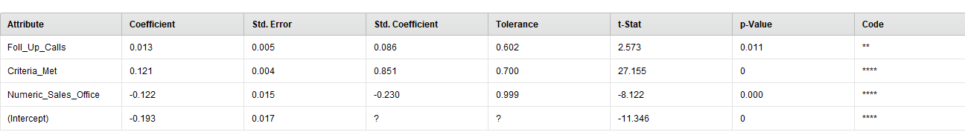
Yhat Probability
score = -0.193 + 0.013*FOLL_UP + 0.121*CRITERIA + 0.-122 * SALES_OFF;
Source is not significant
The real value here is:
The coefficients
The coefficient absolute values
The coefficient significances
The coefficient signs

Slide 16
Peirce’s Trichotomy of the Scientific Method
As Self Correcting Cycles Leading to the “Truth”
Multiple
Hypotheses
Abductive
Reasoning
Begin Next Cycle with Convergence on “Truth”
What are Testable Conclusions About Other Phenomenon That Must Be Reached For Each Hypothesis if True?
Controlled Experiments Based Upon Samples From a Population
Explanatory
Hypotheses
Experience
What Must
Happen If True?
Deductive
Reasoning
Begin Research
Assess Results of Application and Adjust Hypotheses
A Question
Sufficient Accuracy Reached to Take Action
Elimination
of False Hypotheses
(retroduction)
Test Predictive
Models
Execute Actions
Inductive
Reasoning
Assess Accuracy
reflects imaginative interpretation of results.
Economics Plays a Role in Sufficiency Decision.

Slide 17
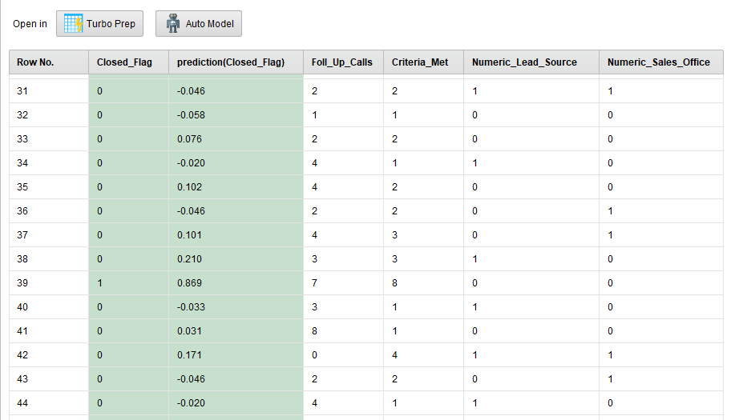
Probability Predictions From Regression Versus Actual
X Variables
Negative Values Inappropriate

Slide 18
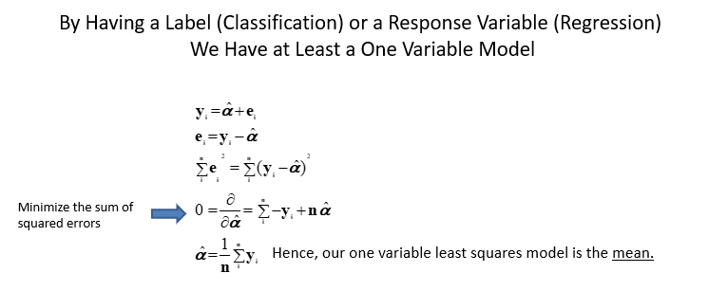
So the Critical Question Becomes: “How much better can I do than the mean of my dependent variable?”. P(Y|X)

Slide 19
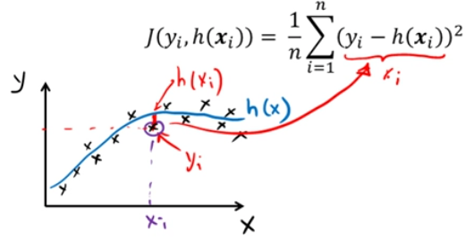
R² = 1-RSS/TSS
Y
Y
Average
Average
X
X
The typical least squares cost function

Slide 20
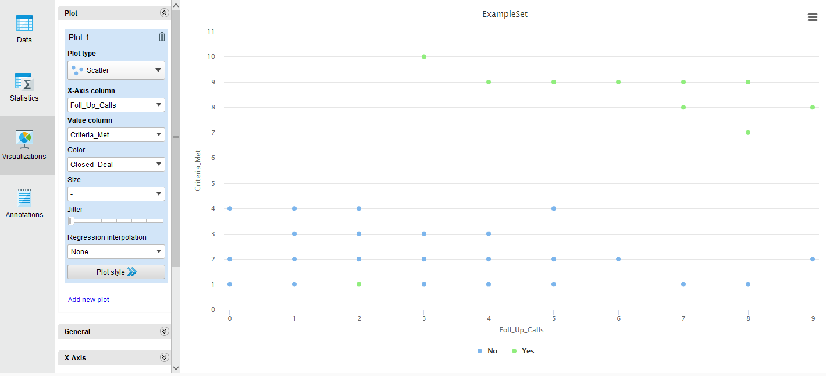
Intuitive Look at Classification and Separability
Do we need both variables in our model?

Slide 21
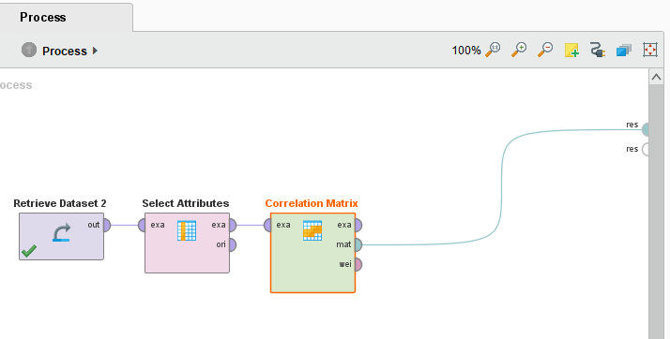
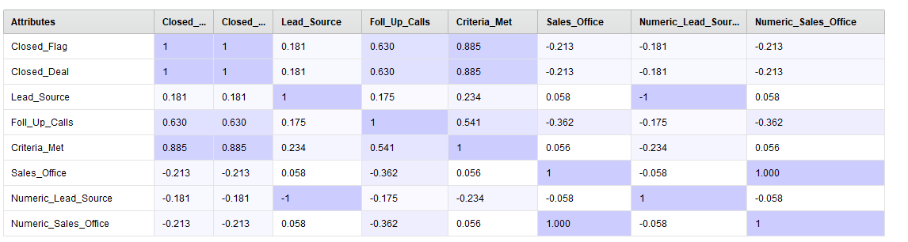
Potential Problems with Multicollinearity When X variables are correlated

Slide 22
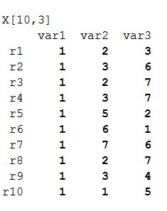
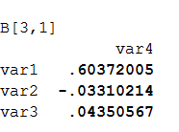
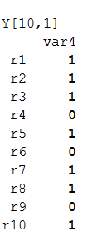
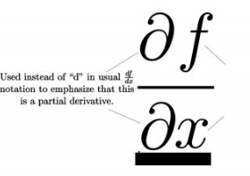
What if this was our dataset?
Regression
Criteria
Follow Up
Goodness of Fit R², MAD, MSE
Hastie et al. use Ꝋ
Matrix X
Intercept
Criteria
Closed?
Follow Up
Partial derivatives of the Y=f(X)
Vector Y
Implies “Cause-Effect” if theory supports

Slide 23
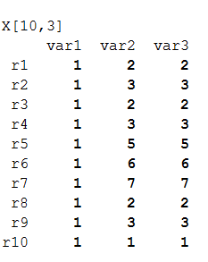
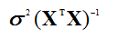
Collinearity
Regression and Multicollinearity
Criteria
Follow Up
Matrix X
Operation fails
Var B=
Identical
There is a trade-off between the number of X variables added and the complexity of the model.
Multi-collinearity
Normal Distribution of Y Assumption
Outliers
Curse of dimensionality (many sparse X variables)
Overfitting/underfitting
Bias versus Variance trade-off
Closed?
Vector Y

Slide 24
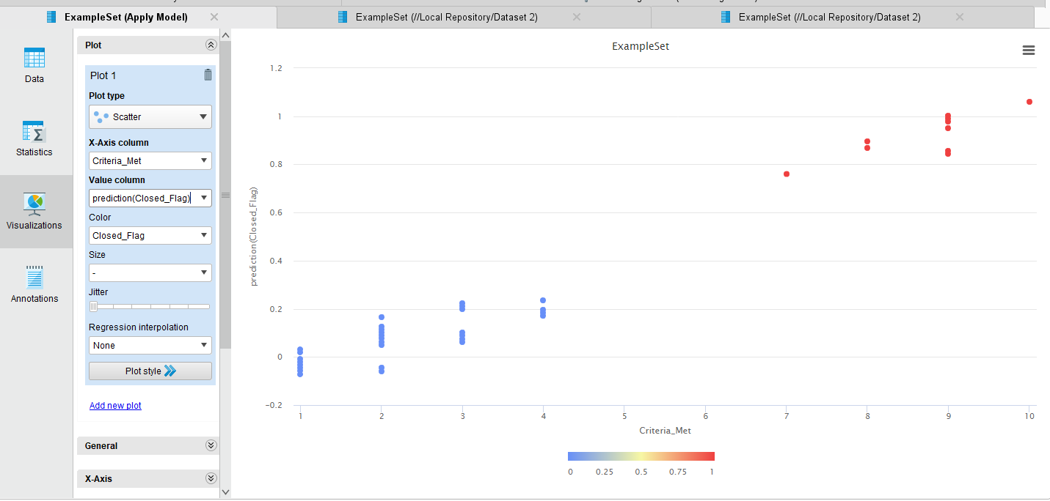
Outliers Can Be a Major Problem With Least Squares Estimators
Outlier

Slide 25
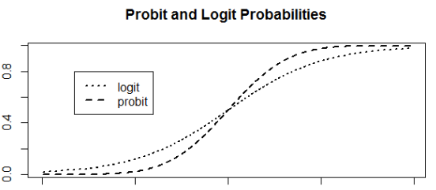
OLS
Probability
X_{i} Variable
Criteria Scores

Slide 26
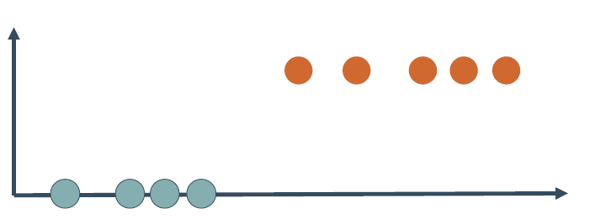
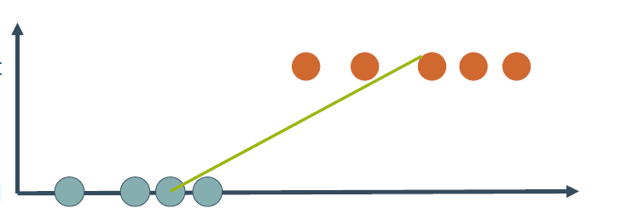
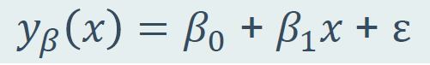
Y
Probability
X
Y
Probability
X

Slide 27
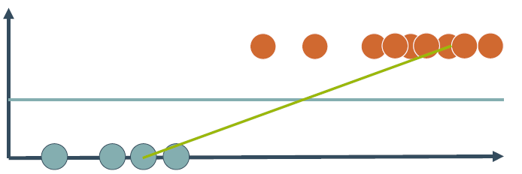
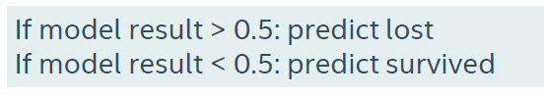
Y
Threshold
X

Slide 28
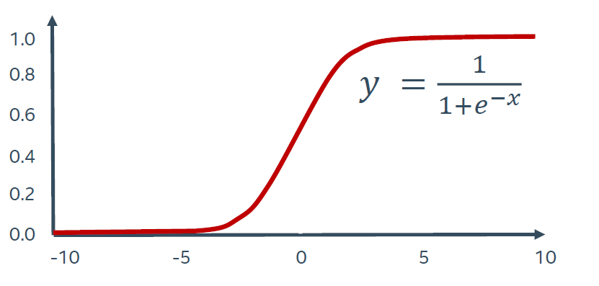
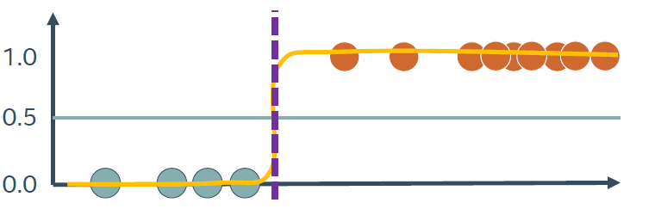
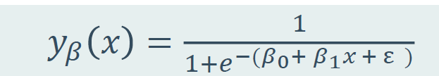
Probability
Classification requires application of a sigmoid (logit) transformation
Y=σ (XB)
X
Probability
X
Predicted Log odds of Y

Slide 29
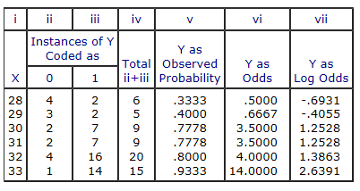
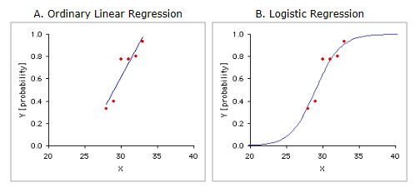
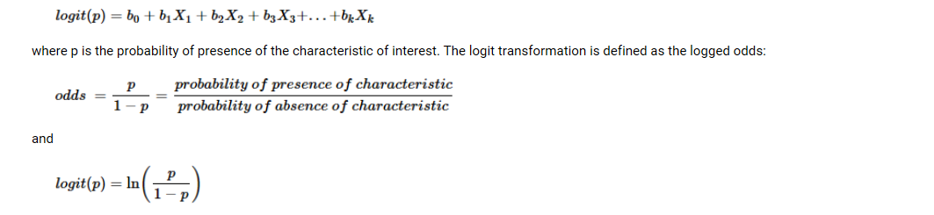
An Intuitive Explanation of Binary Logistic Regression
sales example
X=number of criteria met
Y=Closed/Not Closed deal

Slide 30
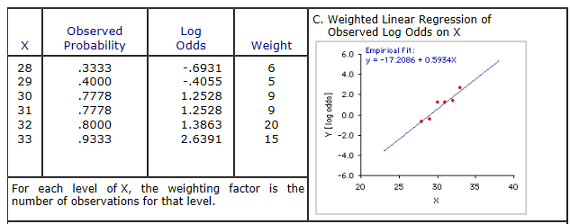

Slide 31
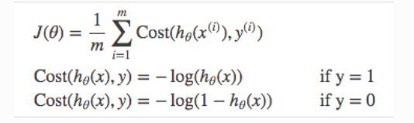
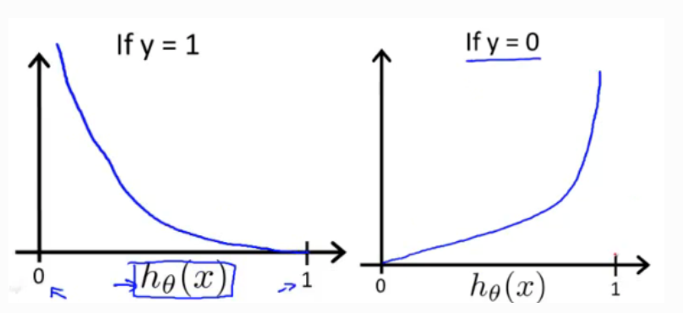
A Little More Rigor…With Logistic Regression We Seek to Minimize a Cost Function
See Mikhail’s video part 8 and Andrew Ng’s shown later
Produces Predicted probabilities

Slide 32
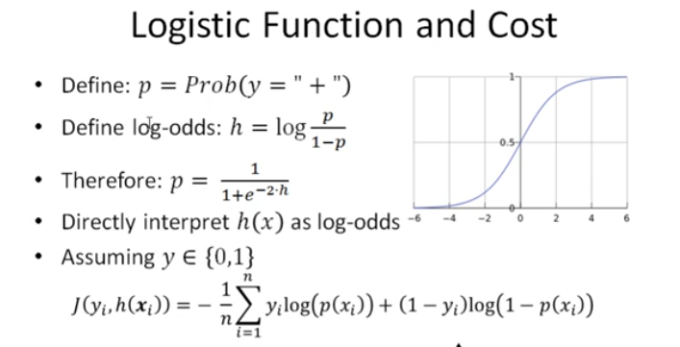

Slide 33
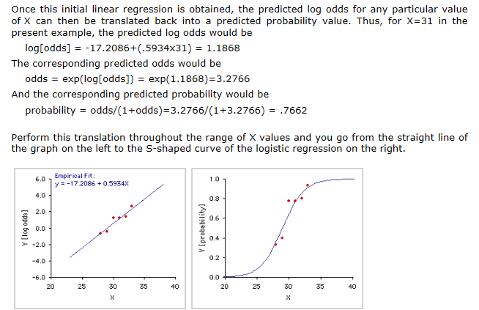
This is sometimes referred to as a “Link Function”
In practice data science software uses maximum likelihood estimation, gradient decent. Refer to Hastie et al starting on page 119 and the four videos by Andrew Ng.

Slide 34
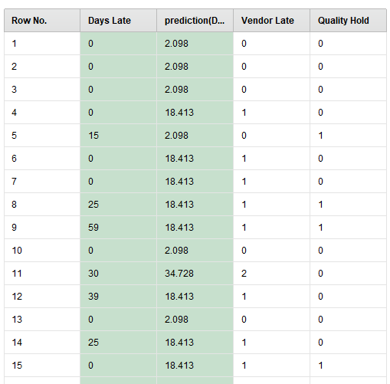
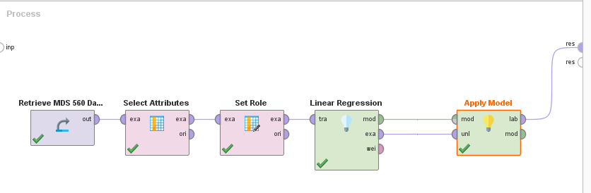
Linear Regression is Treated as Numeric Y = Days Late

Slide 35
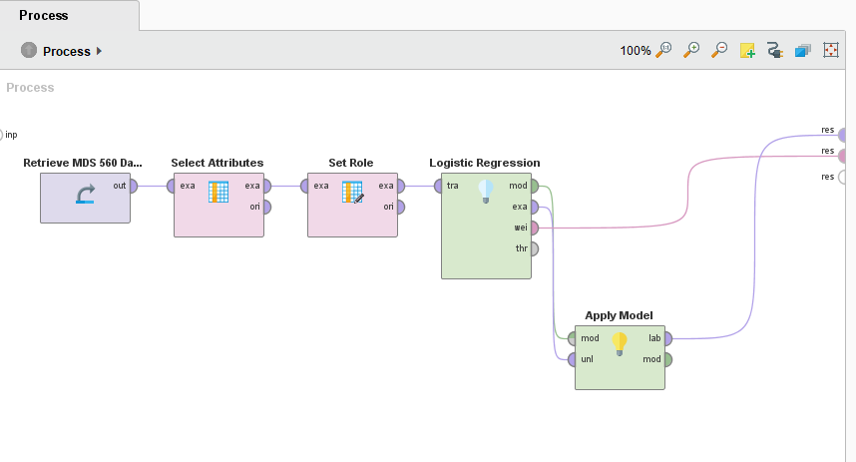
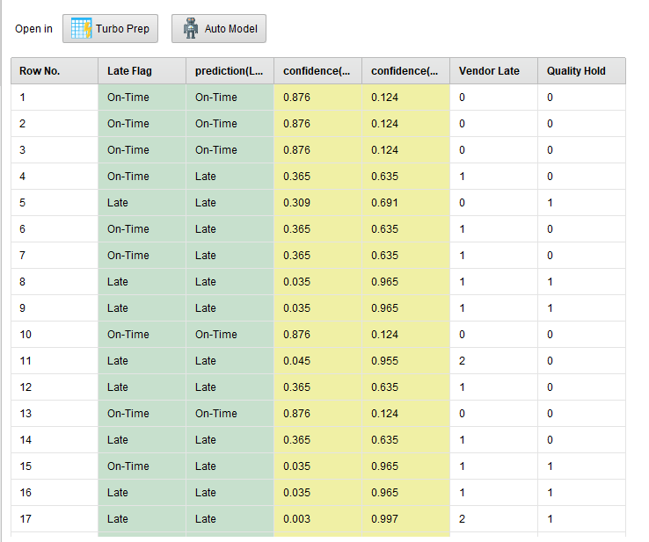
Logistic Regression is Treated as Classification Y = Label On Time/Late

Slide 36
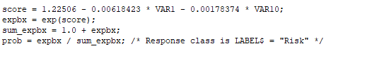
Example of Logistic Regression Code

Slide 37
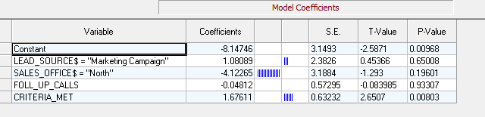
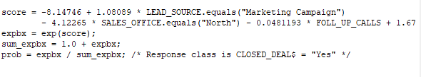
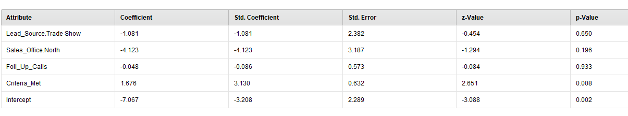
Applying Logistic Regression to Example 2 Using Different Software Packages
SPM
Rapidminer

Slide 38
Optional Videos By Andrew Ng (Stanford) That Will Help You
You Will Cover This in Depth in MDS 556
https://www.youtube.com/watch?v=HIQlmHxI6-0
https://www.bing.com/videos/search?q=logistic+cost+function&&view=detail&mid=E4E30AABEED7EAB97BB0E4E30AABEED7EAB97BB0&&FORM=VRDGAR
https://www.youtube.com/watch?v=blWpQyHCwHE
https://www.youtube.com/watch?v=W9iWNJNFzQI
Also, part 8 of the Salford Systems video by Mikhail provides a helpful discussion on cost functions for logistic regression.

Slide 39

Stochastic Gradient Descent Enables Us to Identify Coefficient Values That Satisfy a Global Minimum of a Cost Function
Learning Rate
Epochs
Coefficient Values

Slide 40


The process produces the values of the parameters theta
score = -7.067 -1.081*(LEAD_SOURCE = “Trade Show")- 4.123*(OFFICE = "North")- 0.048*FOLL_UP + 1.676*CRITERIA;
expbx = exp(score);
sum_expbx = 1.0 + expbx;
prob = expbx / sum_expbx;

Slide 41


Machine learning takes unlabeled data never before seen and provides a prediction
Scoring the Logistic Regression Model

Slide 42


Production Dataset
Training and Testing Dataset (Historical)

Slide 43

Dealing with the Problem of Over Fitting
Courtesy of Intel

Slide 44


Slide 45


Slide 46


Regularization adds penalties for large parameter values

Slide 47

We need to test how well the model generalizes

Slide 48


Slide 49


Slide 50


Slide 51





Slide 52

Number of X Variables

Slide 53


Problems with Overfitting Indicate the Need for Testing the Model with
Hold Outs, Split Samples, K-Fold Cross Validation
These are a trade-off where underfitting leads to increase in bias and overfitting leads to an increase in variance.
Keep in mind the concept of omitted variable bias.

Slide 54


We may choose to accept a small amount of bias if we can reduce variance substantially

Slide 55

Critical Element of Six Sigma
Y=f(x)
Most methods seek to optimize information gain by minimizing a loss function or maximizing some kind of objective function.
Time Series not included in this framework
We want to use data to explain and predict process performance.
Insights to change performance by changing features.

Slide 56

Regression Demonstrates the Concept of Threshold
Closed the Sale
Probability of Closure
Threshold
Did not Close the Sale

Slide 57

Model Performance is a Critical consideration when Y=binomial variable type

Slide 58

Confusion Matrix for Dataset 2 Using Logistic Regression

Slide 59

Evaluating Classification Models

Slide 60



X
X
For ROC, Precision-Recall, Lift-Gain Explanation Watch:
https://www.salford-systems.com/resources/webinars-tutorials/how-to/how-to-interpret-model-performance-with-cost-functions
X

Slide 61


Slide 62

Model Evaluation: Confusion Matrix
Can be Applied to a Test Sample For Validation
Actual training data labels
Proportion of Actual positive cases correctly identified
Proportion of Predicted positive cases correctly classified
Precision
Recall
What the model predicts
Issues
Unbalanced classes: problems using accuracy as a measure, Suggests More Robust Models May be Appropriate
Only 5 out of 1,000 cases are true negatives
Predict all positive: 99.5% accurate but likely useless
Lower accuracy with more balanced classes may be better than higher accuracy given greater class unbalance
Unequal costs and benefits Suggests that Varying the Threshold Could be Useful
Expected value
References: Data Science for Business

Slide 63


Evaluating Performance of a Classification Model in Rapidminer
Sales Example Dataset 2
Confusion Matrix

Slide 64


Performance without the Model
Performance with the Model
AUC=Area Under the Curve
The ROC Curve Shows Trade-offs By Varying Thresholds

Slide 65


The Gains Chart Helps with Cost-Benefit Decision Making
Particularly Useful for Marketing

Slide 66


Lift Reflects the Ratios of Gain to % of Population
Cumulative Lift

Slide 67

Rank ordered in deciles by positive values.

Slide 68

Covered in MDS 561

Slide 69

Feature Engineering Enables Us to Build Validated Models To Improve Predictive Accuracy and Information Gain
We Try to Add Stronger and Stronger Predictors

Slide 70


Feature Engineering Enables Us to Build Validated Models To Improve Models and Secure Information Gain
Training Results
After Validation
Information Gain
Guessing
Appearance of High Information Gain
Testing Indicates No Information Gain from the Model. (Random guessing just as effective)

Slide 71


Slide 72


A Confusion Matrix
We Must Also Distinguish Between A Training Dataset and A Testing Dataset
Double Click

Slide 73



Slide 74



Slide 75


Slide 76


Slide 77

Dataset 3a--Description
a

Slide 78

Label—Bring in as a binomial
Dataset #3a Provides Examples of X>100 Variables and Sparsity. It is an Unbalanced Dataset

Slide 79

Dataset 3a: The Unbalanced Situation

Slide 80


Example of Using Sample Operator for Balancing Samples by Classes
Automodel includes a sampling operator
Recall for True “1’s” is poor

Slide 81


Example of Leaving the Dataset Unbalanced

Slide 82


Dataset 3a—Accuracy Versus Recall

Slide 83

Naïve Bayes Has Given Us Good Recall For a Huge Cost in Precision
There is No Such Thing as a Free Lunch
The ROC Curve Defines the Tradeoff Envelope
Your Choice of Model Depends Upon Your Objectives (i.e. Costs)

Slide 84


Slide 85



Slide 86


Long wait time
Bootstrapping Validation

Slide 87



Slide 88



Slide 89


Slide 90


Slide 91
Appendix

Slide 92


Slide 93


Slide 94


Slide 95


Slide 96


Slide 97


Slide 98


Slide 99


